Slide 1

TECH CLEANERS WELCOME ALL

Slide 2

SMART DUSTBIN

Slide 3
INTRODUCTION
Being the citizens of a developing nation it is very essential to design a project which caters to the needs of wide range of people focusing on their health and hygiene in an efficient manner.

Slide 4
SUSTAINABLE GOALS
The Sustainable Development Goals (SDG’s) are a collection of 16 global goals set by the UNITED NATIONS GENERAL ASSEMBLY in 2015 for the year 2030.
Good health and well being is one of the sustainable goals that our project meets .

Slide 5

GOOD HEALTH AND WELL BEING
Ensure healthy lives and
promote well-being for all at all ages
SWACHH BHARAT MISSION
Our project also focuses on Swachh Bharat Mission intiated by central government of India for the period of 2014 – 2019.

Slide 6
OBJECTIVE
To design a smart bin
Which monitors the amount of waste by IOT technology.
Which helps to reduce human intervention by automatic opening and closing of bin lid.
Which helps to reduce human time and effort.
Which works on self power generation such as solar powered bin .
Which protects the components of the bin by anti theft system .

Slide 7
TIME PHASE CHART
TIME PHASE CHART- 2019-20
 | JULY |  |  |  | AUGUST |  |  |  | SEPTEMBER |  |  |  | OCTOBER
PLANS | I | II | III | IV | I | II | III | IV | I | II | III | IV | I | II
FORMING THE TEAM
TEAM DISCUSSION
SELECTION OF THE PROBLEM
ABSTARCT CREATION
IDEA GENERATION
DESIGN PHASE
ASSEMBLING PHASE
TESTING PHASE
- PLANNED

Slide 8
BLOCK DIAGRAM
PROBLEM SELECTION
GROUP DISCUSSION
IDEA GENERATION
IDEA ANALYSIS
RESEARCH AND REFERENCE
ASSEMBLING THE PARTS
PRODUCT DESIGNING
HIGHLIGHTING THE FEATURES
TESTING AND QUALITY CONTROL
FINISHED PRODUCT
FUTURE SCOPE

Slide 9
BUDGET
EQUIPMENTS | QUANTITY | PRICE(Rs.)
ARDUINO BOARD(UNO) | 1 | 420
ULTRASONIC SENSOR | 2 | 260
MALE TO MALE JUMPER WIRES | 30 | 120
FLOW METER | 1 | 150
WIFI MODULE | 1 | 300
SOLAR PANEL | 1 | 90
MALE TO FEMALE JUMPER WIRES | 10 | 40
LITHIUM ION BATTERY | 1 | 250
CHARGER | 1 | 100
BREAD BOARD | 1 | 40
VOLTAGE BOOSTER | 1 | 75
SPRINKLER | 1 | 100
WATER PUMP MOTOR | 1 | 200
TOTAL COST |  | 2145

Slide 10



IDEAS
IDEA
IDEA
IDEA
1
2
3
Automatic
Opening
And
Closing of bin lid
Garbage
Monitoring
System
Using
Cloud
technology
Self power generation using solar panel.

Slide 11
IDEA
IDEA
4
5
Anti theft system using
Weight sensors and
Interactive
Efficient
Removal
Of
Garbage
11

Slide 12
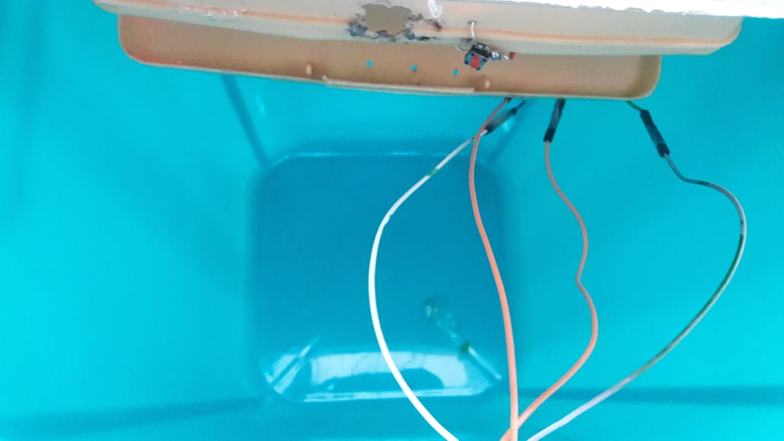
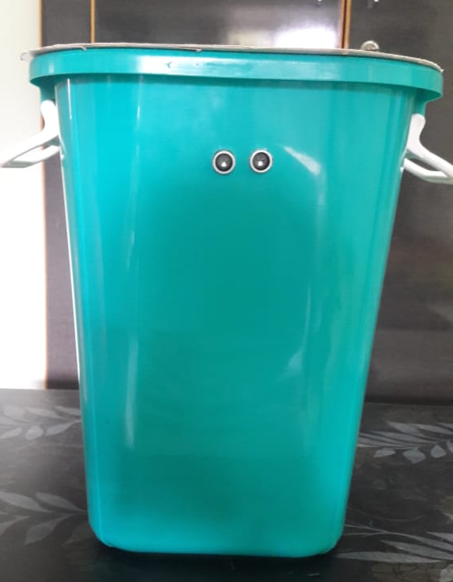
DESIGN OF DUSTBIN
INNER VIEW OF BIN
FRONT VIEW

Slide 13

AUTOMATIC OPENING AND
CLOSING OF BIN LID

Slide 14
MATERIALS REQUIRED:
S.NO | MATERIALS REQUIRED | QUANTIY
1 | ARDUINO UNO | 1
2 | ULTRASONIC SENSOR (HC SR04) | 1
3 | SERVO MOTOR (SG90) | 1
4 | CONNECTING WIRES | as required
5 | ARDUINO IDE | 1

Slide 15
CONCEPT:
The concept behind this idea is object detection .
In this methodology ultrasonic sensor is placed in the front side of the bin.
Whenever ultrasonic sensor detects the human presence it will trigger the arduino to open the lid of the smart dust bin .

Slide 16
CONNECTIONS:
ULTRASONIC SENSOR:
Vcc pin to 5V supply.
Trig pin to digital pin 2.
Echo pin to digital pin 3.
Ground pin to ground pin on board,
SERVO MOTOR
Power pin to 5V supply.
Ground pin to ground terminal on board.
Signal pin to digital pin 12.

Slide 17
FLOW CHART :
POWER SUPPLY
RECEIVES INPUT FROM
ULTRASONIC SENSOR
SENSOR SENDS
PULSE TO THE
MOTOR VIA
ARDUINO
HUMAN
PRESENCE<=
25 CM
YES
NO
SERVO MOTOR OPENS THE LID.

Slide 18
WORKING
Power supply is given to the ultrasonic sensor
The sensor detects the human inception
When there is an interception for less than 25cm a pulse is sent to the arduino
The arduino then sends the impulse to the servo motor which opens the lid
The lid closes when the inception gets cleared

Slide 19
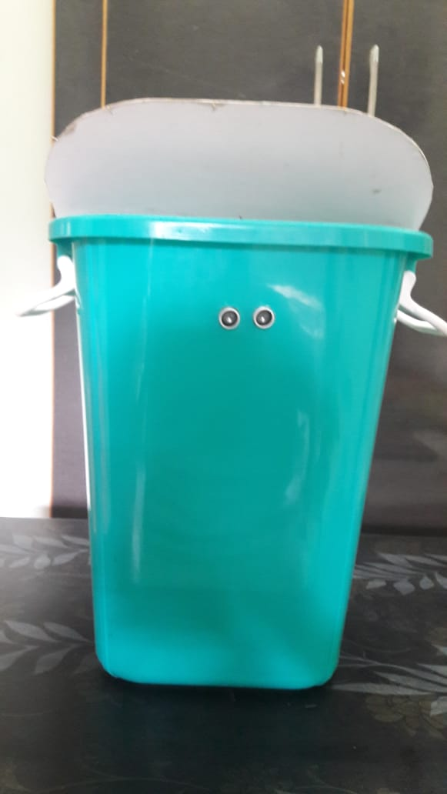
OUTPUT:
Output for automatic opening and closing of bin lid using
Ultrasonic sensor

Slide 20
GARBAGE MONITORING
SYSTEM USING CLOUD TECHNOLOGY.

Slide 21
MATERIALS REQUIRED
S.NO | MATERIALS REQUIRED | QUANTIY
1 | ARDUINO UNO | 1
2 | ULTRASONIC SENSOR (HC SR04) | 1
3 | EPS8266 WIFI MODULE | 1
4 | WEIGHT SENSOR | 1
5 | CONNECTING WIRES | as required
6 | ARDUINO IDE | 1

Slide 22
CONCEPT
The concept behind this idea is object detection and distance calculation.
In this methodology we use a ultrasonic sensor that detects and calculate the quantity of waste collected.
By using the principle of ultrasonic sensor .

Slide 23
CONNECTIONS
ULTRASONIC SENSOR
Vcc pin to 5v supply on arduino.
Trig pin to digital input 2 on arduino.
Echo pin to digital input 3.
Ground terminal to ground on arduino.
EPS8266 WIFI MODULE
RX pin to series connection of resistor .
GPIO pin to ground terminal .
2TX pin to 10 th terminal on board .
Enable pin and vcc pin is given to 3.3v supply as supply more than 3.3v will damage the module .

Slide 24
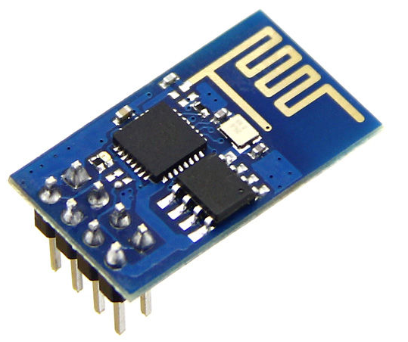
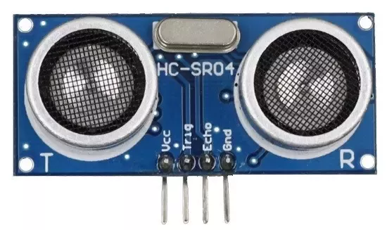
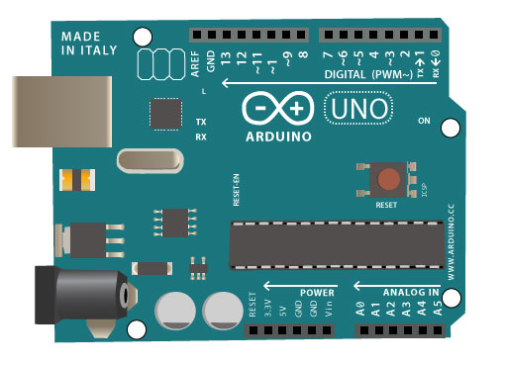
SCHEMATIC REPRESENTATION
CLOUD
BLYNK /HTML WEB PAGE

Slide 25
FLOW CHART:
POWER SUPPLY
RECEIVES INPUT
FROM THE USER.
UPDATE THE STATUS
OF BIN TO CLOUD.
CHECK WHETHER
THE BIN IS FULL
MORE THAN 75%
OR THE BIN IS 25%
FULL FOR 2 DAYS
SENDS INFORMTION
TO CONCERNED
DEPARTMENT
YES
NO
BIN GETS CLEANED
BIN IS EMPTY
UPDATE THE STATUS
OF BIN TO CLOUD.

Slide 26
WORKING
Power supply is given to the ultrasonic sensor and the weight sensor
The ultrasonic sensor detects the level of garbage and the weight sensor monitors the weight of the garbage collected.
If the level of garbage is more than 75% or if the bin is of 25% full for 2 days or if the weight is more than 18 kgs the impulse is sent to the arduino.

Slide 27
The arduino in turn sends the impulse to the EPS8266 Wi-Fi module regarding the garbage generated and the data gets stored in cloud platforms such as blynk or HTML webpage .
Concerned authorities gets intimation regarding status of the bin so that they can send the garbage collecting vehicle prior to overflow.
Once again status of bin gets uploaded to cloud platforms.

Slide 28
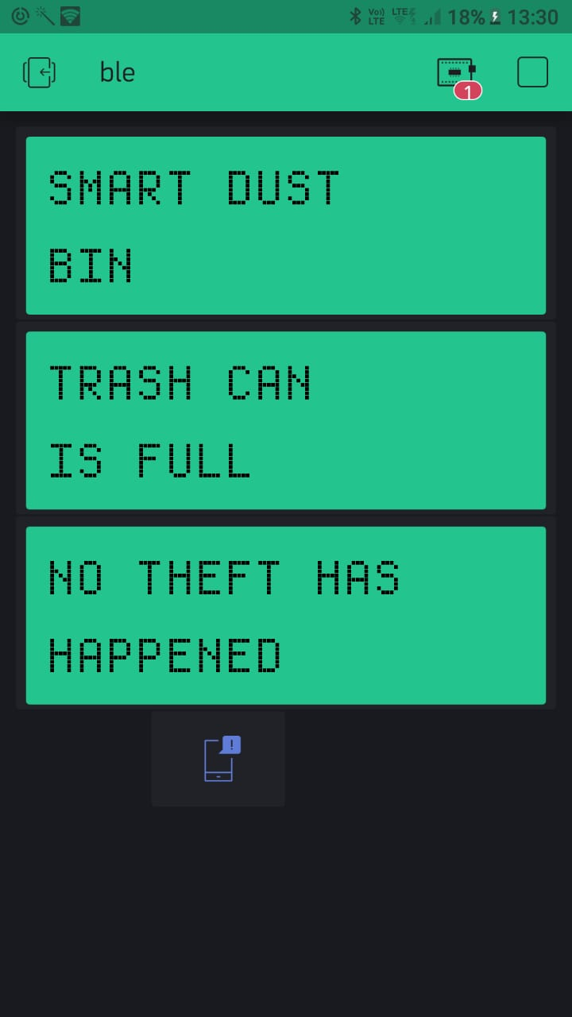
OUTPUT:
Output of garbage monitoring system when TRASH CAN IS FULL and NO THEFT DETECTION.

Slide 29
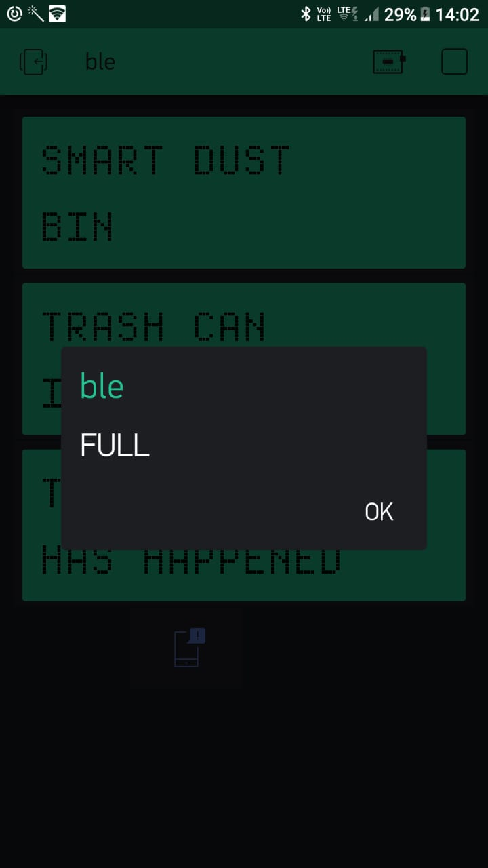
OUTPUT:
Output of garbage monitoring system when TRASH CAN IS FULL – popup message with a notification sound

Slide 30
SELF POWER
GENERATION USING SOLAR PANEL.

Slide 31
MATERIALS REQUIRED
S.NO | MATERIALS REQUIRED | QUANTIY
1 | ARDUINO UNO | 1(same)
2 | SOLAR PANEL | 1
3 | LI ION BATTERY | 1
4 | VOLTAGE BOOSTER | 1
5 | BATTERY CHARGER | 1
6 | IC 7805 | 1
7 | CONNECTING WIRES | As required.

Slide 32

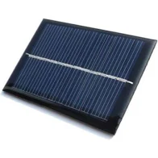
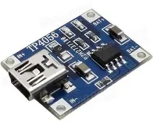
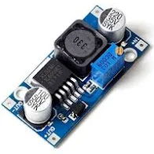
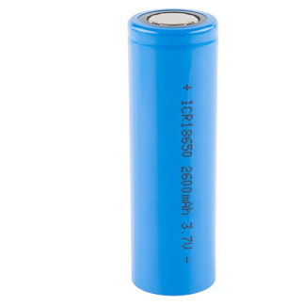
SCHEMATIC DIAGRAM

Slide 33
WORKING
The solar panel is fitted on the top of pole of the bin
The voltage generated by the solar panel is then fed to the lithium ion battery charger through a IC 7805
The charger charges the lithium ion battery
The battery is connected to a voltage booster which then supplies the voltage to the arduino for its working .

Slide 34
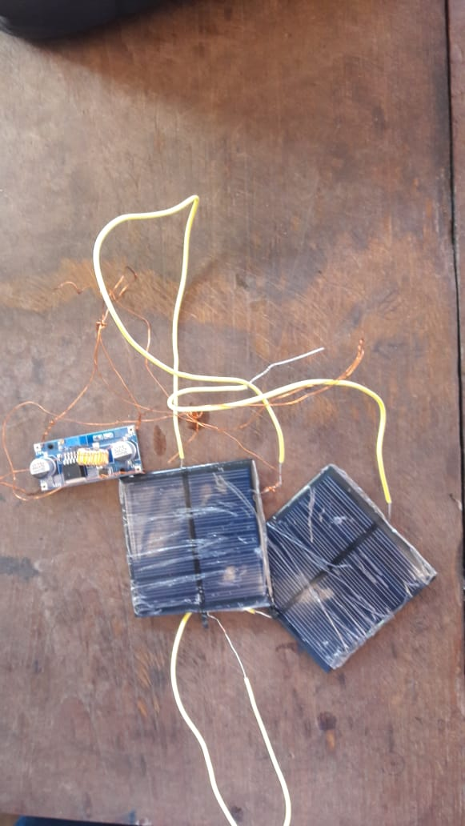
IMPLEMENTATION
Solar panel with voltage booster

Slide 35
ANTI THEFT SYSTEM USING PUSH BUTTON SWITCH

Slide 36
MATERIALS REQUIRED
SNO | MATERIALS REQUIRED | QUANTITY
1 | PUSH BUTTON | 1
2 | CONNECTING WIRES | 1

Slide 37
FLOW CHART
POWER SUPPLY
WHEN PUSH BUTTON
IS PRESSED
THEFT DETECTED
IF SENSOR VALUE ==0
true
FALSE
NO THEFT
DETECTED

Slide 38
WORKING
Here we are going to use a push button switch , we will be placing this switch nearer to the lock of a box where all the boards , ultrasonic sensor and wifi module is placed
When the box is closed the button is pressed and it send logic 0 to arduino and is programmed in such a way that when it has logic 0 on a particular pin it sends no theft happened message to blynk app to display it and vice versa happens when box is opened.

Slide 39
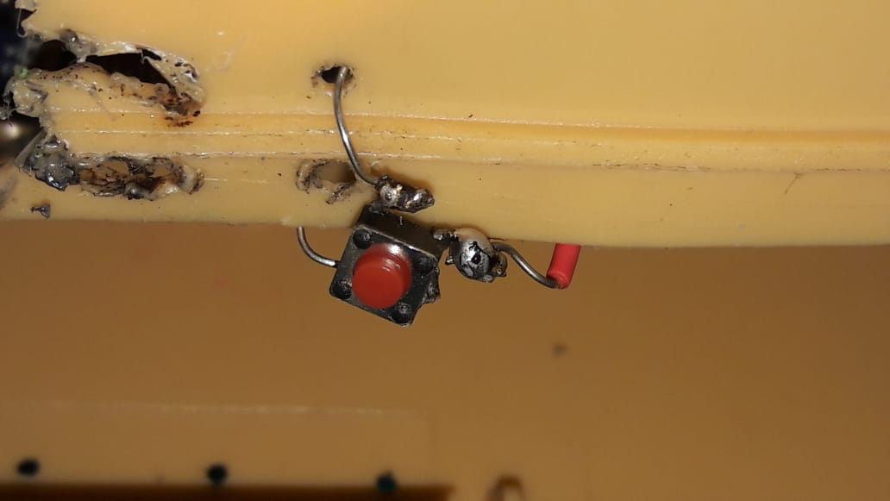
DESIGN:
.Push button
Used for anti
Theft system.

Slide 40
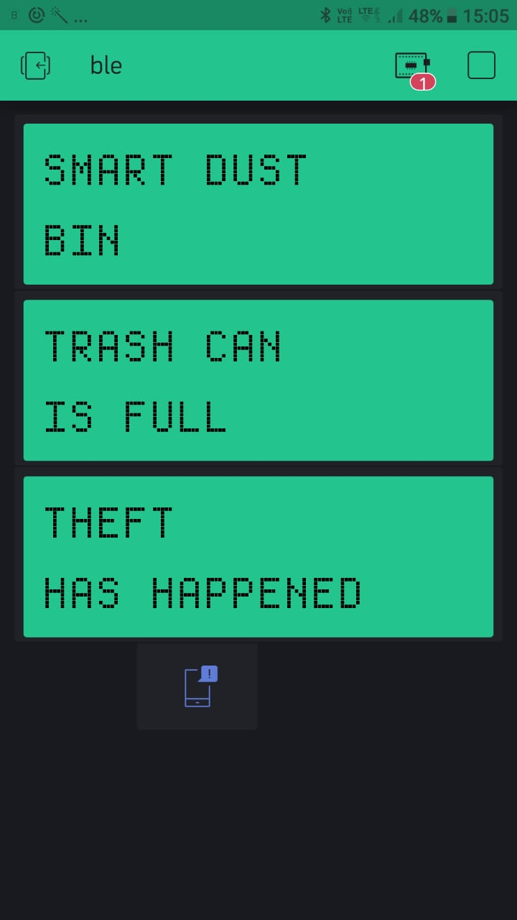
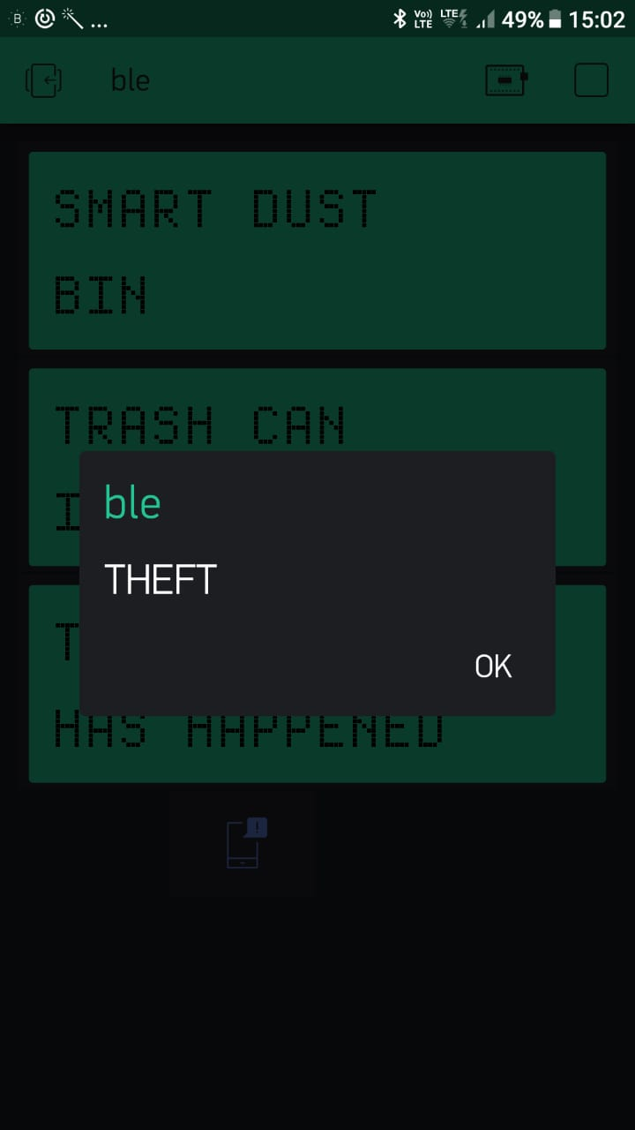
OUTPUT
Theft display and popup
Message when theft
happened

Slide 41
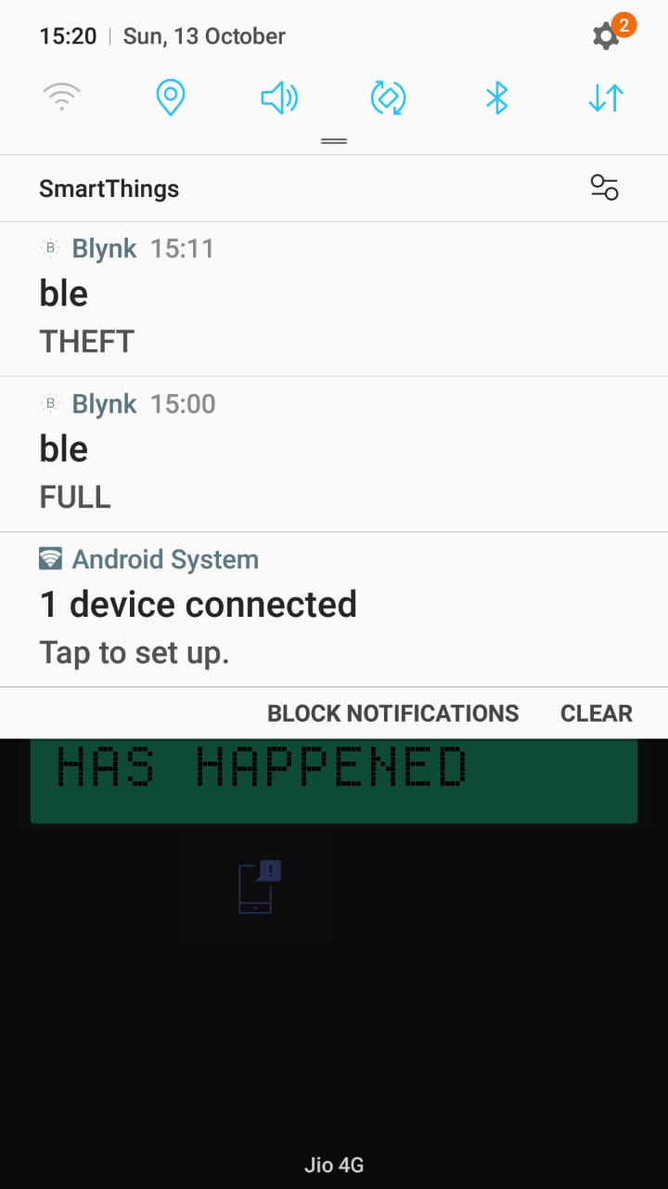
OUTPUT
It can display the
Message with a
popup
Sound when
the phone is
In sleep mode.

Slide 42
EFFICIENT REMOVAL OF
GARBAGE USING EASY RETRACTABLE
GARBAGE BAG

Slide 43
WORKING
The bin at the front consists of a small open and close door which has a magnetic lock system
The workers can open the door and can remove the garbage collected in the bin using easy retractable garbage bag.
Once the garbage is removed the worker closes the door

Slide 44
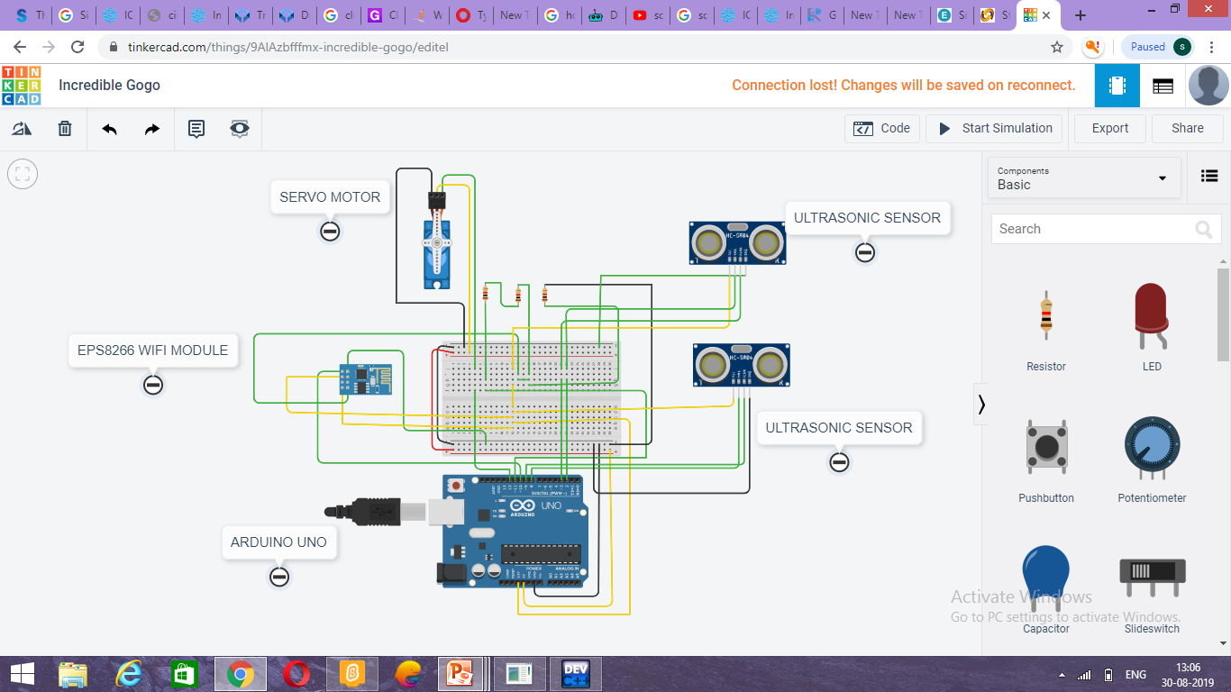
CIRCUIT DIAGRAM

Slide 45
CIRCUIT EXPLANATION:
Usually ultrasonic sensor (HC-SR04) has four terminals such as Vcc pin ,trig pin,echo pin, ground pin .
Likewise servo motor (SG90) has three terminals such as power,signal,ground.
In the circuit diagram,
Power supply = yellow coloured wires.
Signals = red coloured wires.
Ground connection = black coloured wires.

Slide 46
CONSTRUCTION
A smart square shaped bin which is fitted with the help of a pole that consists of a solar panel at the top
The bin also has an LCD display in it with the features of magnetic lock system door.
The inbuilt components found in the bin are
Arduino UNO
Ultrasonic sensors HC SR04
Weight sensor
ESP8266 Wi-Fi module
Bread board with wired components
Servo motor.
Lithium ion battery.
Li ion battery charger
Voltage booster.
LCD display

Slide 47
WORK DONE SO FAR
The problem has been selected with a specific objective.
Techniques and designing methods involved in this project were brainstormed.
Wide range of references is being done in improving the design of our project.
The features to be included have been brainstormed and designed with great care

Slide 48
Even the minute details were taken care while designing the project.
All ideas have been designed with the pre requisite knowledge
Trial and error has been done on the miniature prototype.
The major portion of the circuit has been designed for our project
It is decided that the smart bins will be placed in areas where the amount of waste collected is in large scale

Slide 49
AFTER THIS REVIEW
A test on the efficiency of different components inbuilt in the smart bin will be carried out
After ensuring,assembling of all the components will be done to get the complete desired prototype
After the assembling process different quality control tests will be done which in turn brings a quality product
The required data for placing the bin in specific locations will be collected from the concern municipal department.

Slide 50
REFERENCES
https://circuitdigest.com/microcontroller-project/iot garbage monitoring using arduino.
https://zentronics.com.my/arduino-esp8266-smart -bin-monitoring using blynk-apps.
https://www.un.org/sustainable goals.
SIMULATION TOOL
Tinker cad by autodesk(for circuit diagram)

Slide 51
JOURNALS REFERED
International journal of innovative research in electrical,electronics,instrumentation and control engineering.smart garbage monitoring system using iot.
International journal of computer science engineering and information technology(IJCSEIT),vol 7,5th oct 2017 multiagent based iot smart waste monitoring and collection architecture

Slide 52
By david likotikt,devotha nyambo,joseph mwangoka.
International journal of latest technology in engineering ,management and applied science(IJLTEMAS),VOL 6,dec 2017 smart dustbin with gsm and arduino module
By MD Aamir enam,sarfaraj khan,barsha singh,neha kumari.

Slide 53
LECTURE VIDEOS
Introduction to arduino by sudip mishra (IITKGP),nptel,21 jan 2017.
Arduino tutorial, channel:electronic jugaad,9 jan 2017.
ESP8266 wifi module setup using arduino uno,channel:uelectropro,19 dec 2015.

Slide 54
THANK YOU

